Slide 1

Six week training on "Machine learning"
Name - shivansh sharma
b.tech (ece) 5th sem
17042100309

Slide 2

Traing details:
Institute: Internshala
Mode of training: Online
Start date: 1 june
End date: 17 july
Duration: 47 days
Number of hours: 60 hrs

Slide 3
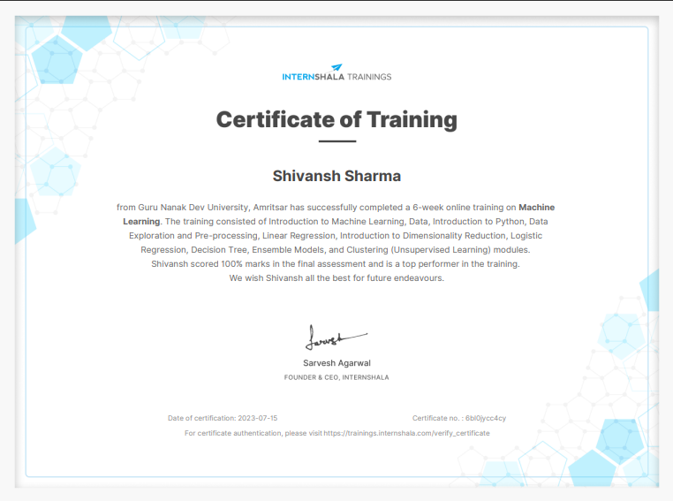
My training certificate

Slide 4
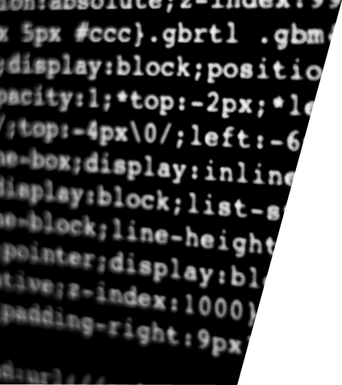
content
Intro. To machine learning
Types of machine learning
Linear regression
Logistic regression
Decision tree
Feature engineering
Basic of Ensemble models
Random forest
clustering

Slide 5
First chapter

Slide 6
iNTRODUCTION TO MACHINE LEARNING
From facebook to finance, from science to security, the expanse of Machine Learning algorithm has reached every stratum. Humans are vulnerable and susceptible to overestimation and under estimation but not the machine. Even scientific predictions are steering more towards discovery by machine learning implementations.
Machine Learning is a method of teaching machines to learn things and improve predictions/ behaviour based on data on their own. It is widely used in our day today life for example Amazon Recommedation System, Personalised search engine etc

Slide 7

Types of machine learning
SUPERVISED LEARNING: The past data is known and we have the data of the target we are trying to predict.
Supervised learning classified into two categories of algorithms:
Classification: A classification problem is when the output variable is a category, such as "Red" or "blue" or "disease" and "no disease".
Regression: A regression problem is when the output variable is a real value, such as "dollars" or "weight".
UNSUPERVISED LEARNING
Clustering: A clustering problem is where you want to discover the inherent groupings in the data, such as gropping stomers by purchasing behavior.

Slide 8
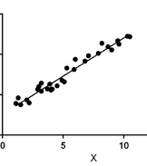
Linear Regression is a machine learning algorithm based on supervised learning.
It performs a regression task. Regression models a target prediction value based on independent variables.
Linear regression performs the task to predict a dependent variable value (y) based on a given independent variable (x). So, this regression technique finds out a linear relationship between x (input) and y(output). Hence, the name is Linea
Linear regression

Slide 9
Logistic regression
Logistic regression is basically a supervised classification algorithm. In a classification problem, the target variable (or output), y, can take only discrete values for given set of features (or inputs), X.

Slide 10
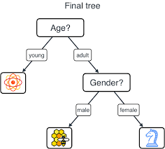
Decision tree
A decision tree is a tree-like model that acts as a decision support tool, visually displaying decisions and their potential outcomes, consequences, and costs. From there, the “branches” can easily be evaluated and compared in order to select the best courses of action.

Slide 11
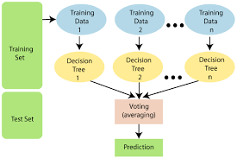
Random forest
Random forest is a supervised learning algorithm which is used for both classification as well as regression. But however, it is mainly used for classification problems. As we know that a forest is made up of trees and more trees means more robust forest. Similarly, random forest algorithm creates decision trees on data samples and then gets the prediction from each of them and finally selects the best solution by means of voting

Slide 12
Second chapter

Slide 13

Project
Project :

Slide 14

Made a python file in jupyter notebook as loan_prediction.ipynb
This Photo by Unknown author is licensed under CC BY-SA-NC.

Slide 15
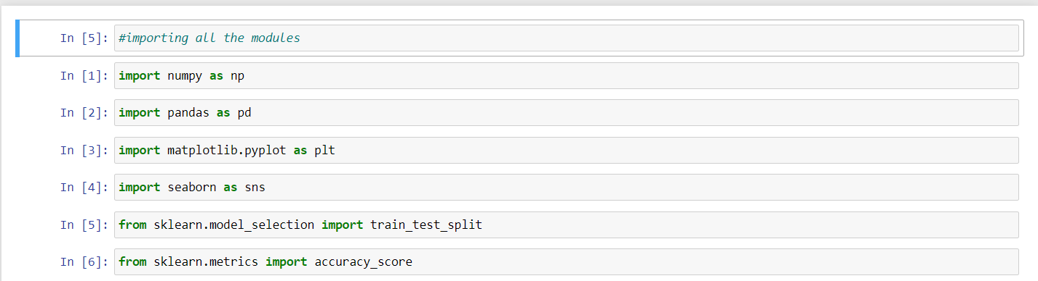
Libraries used
Tkinter for GUI
Numpy for mathematical operations
Pandas for working with data sets
Matplotlib for statistics
Seaborn for data science and machine learning tasks
Sklearn for classification, regression, clustering and dimensionality reduction, etc.

Slide 16
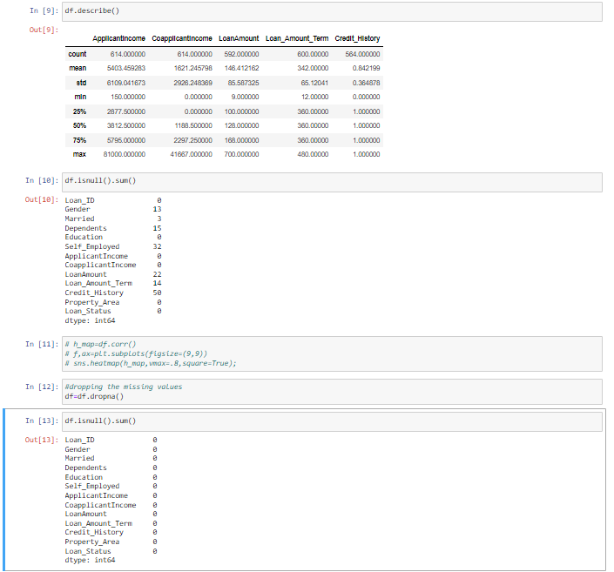
Deleting the rows having null values from csv file

Slide 17
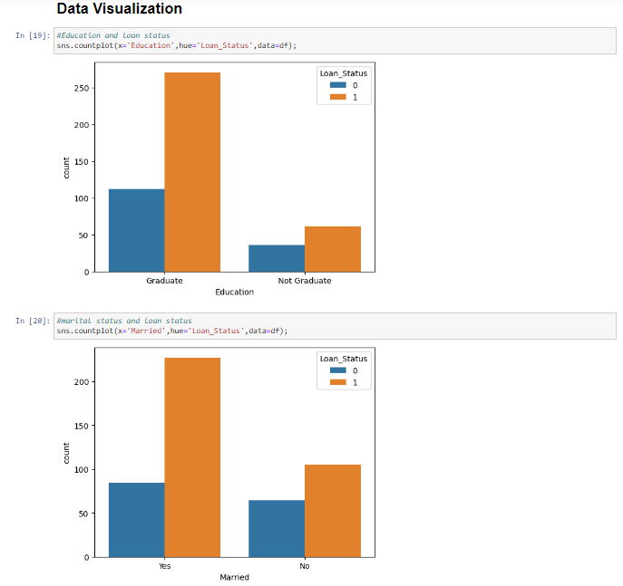
Data visualisation
Ploting bar chart graph based on graduation , marital status , gender , employment and property area.

Slide 18
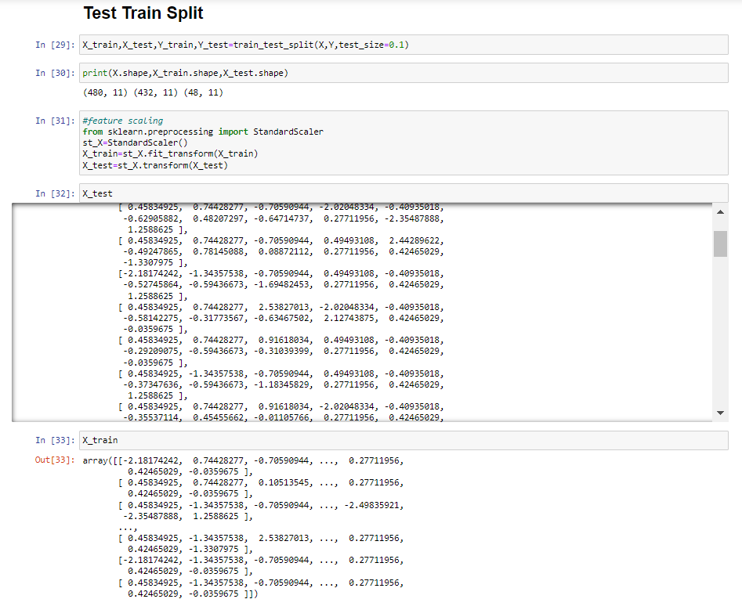
Test train split is done at the ratio of 10 is to 90 i.e., 10%=testing data 90%=training data

Slide 19
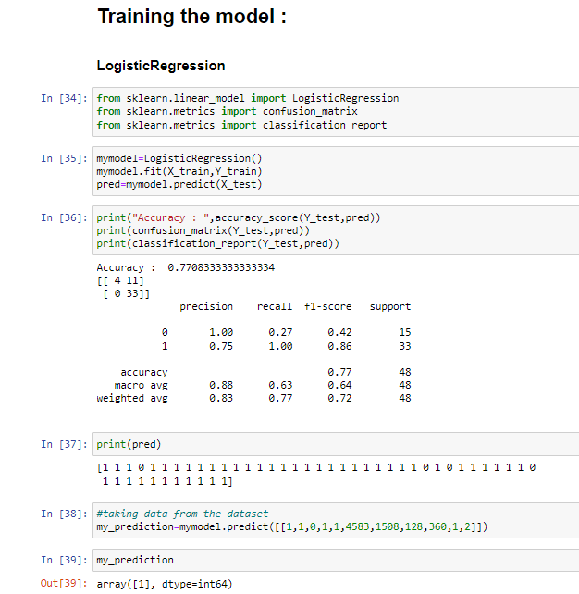
Training the model
For training ,I have used logistic regression which is a process of modeling the probability of a discrete outcome given an input variable.

Slide 20
Made another python file in jupyter notebook as Myapp.ipynb which will end up running as a GUI interface.
This Photo by Unknown author is licensed under CC BY-SA-NC.

Slide 21
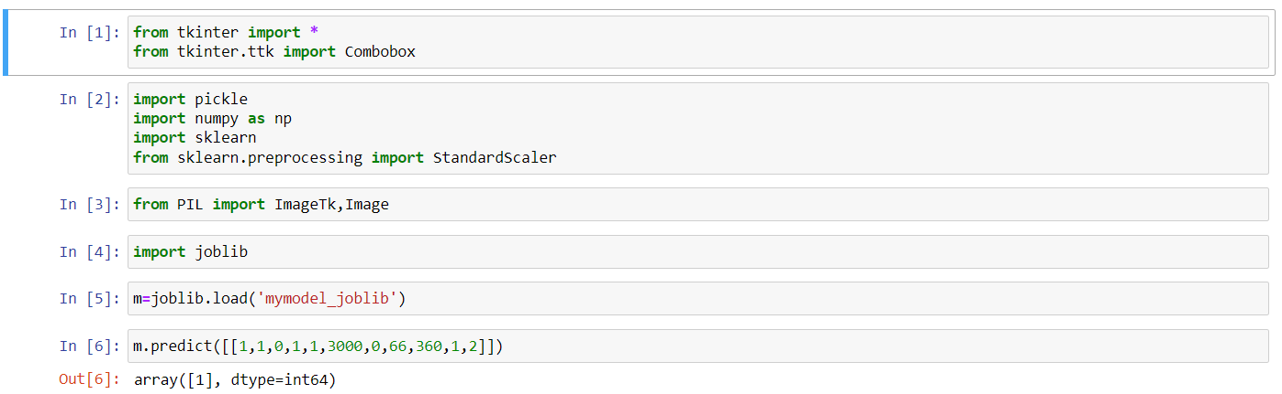
Importing some libraries from python

Slide 22
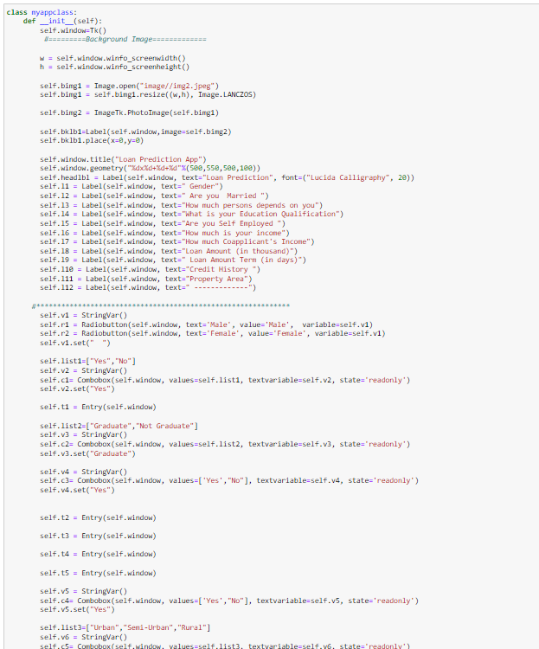
Created a class named as myappclass .
In this, code for design of GUI has been written.
All the labels , typing space and the buttons are set according to x-axis and y-axis as per the requirement.

Slide 23
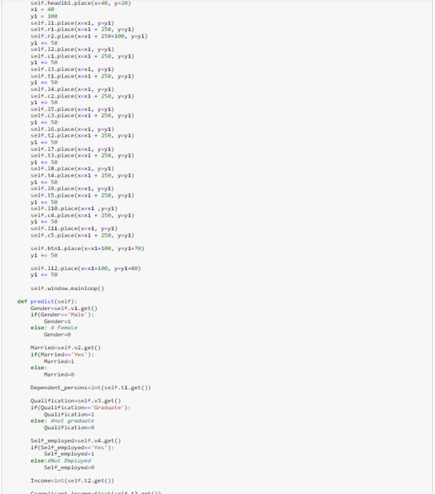

Slide 24
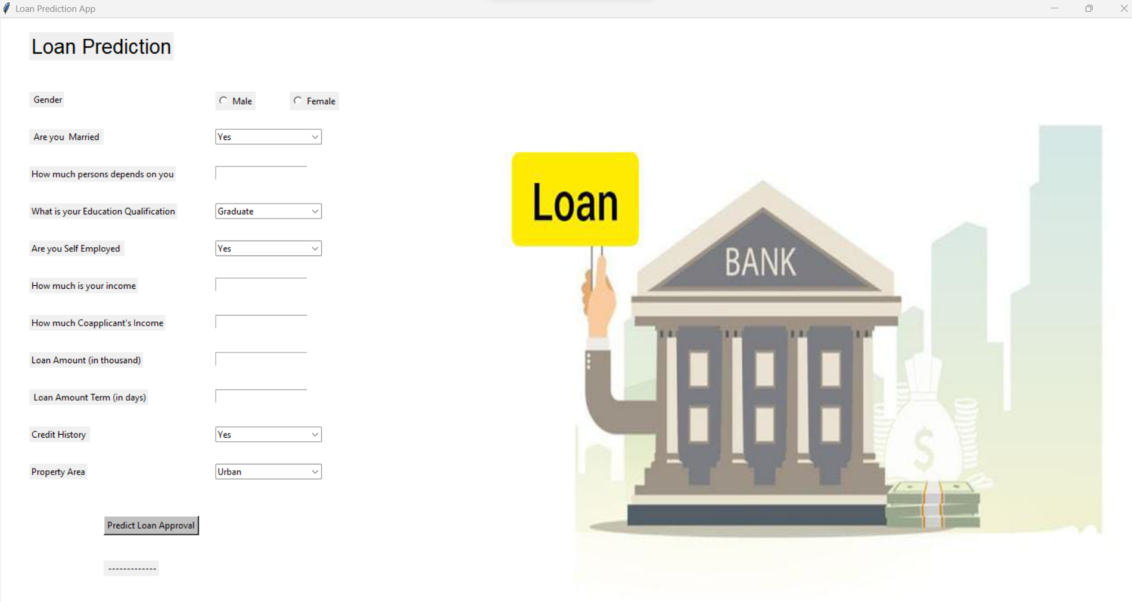


At last , call the myappclass() and this kind of interface will be ready for the predictions.
24

Slide 25



Shivansh Sharma
+91 7719600539
Shivansh0539@gmail.com

